Slide 1
NBA Game Winner and Statistics Classification
Prabjyot Obhi, Janaarthana Harri Palanisamy, Philip Salire
CMPE 255, SJSU Spring 2021

Slide 2



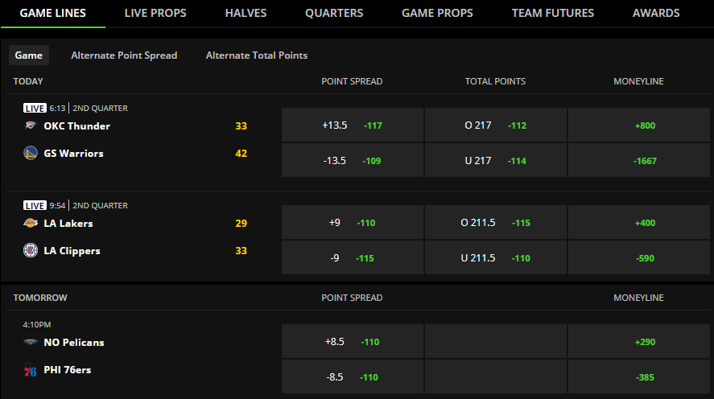

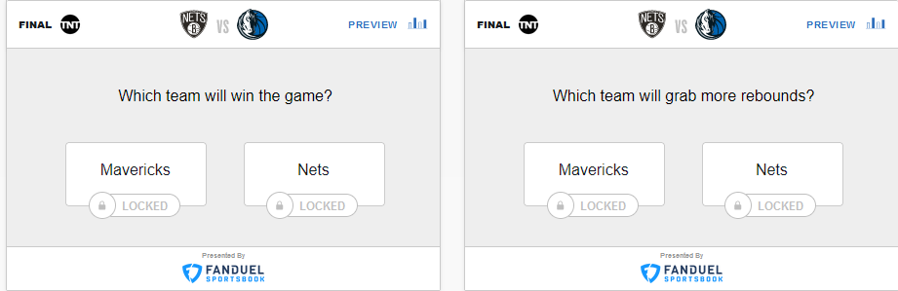
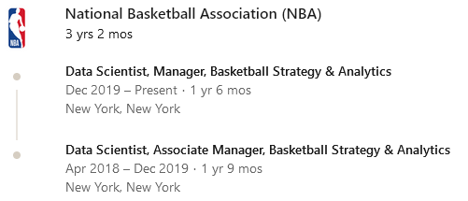

Introduction
Sports produce large, high-dimensionality datasets
Plethora of statistics generated every game
Applications/Market
Sports Analytics
Analyze data to aid teams in decision making, e.g. in coaching
Sports Betting
Market size worldwide: 608 Billion USD

Slide 3

Dataset
All NBA Game and Player Statistics 2003-2020 (Kaggle)
23,520 rows for team stats
585,795 rows for player stats
Approach
Use past statistics to predict future winners and statistics

Slide 4
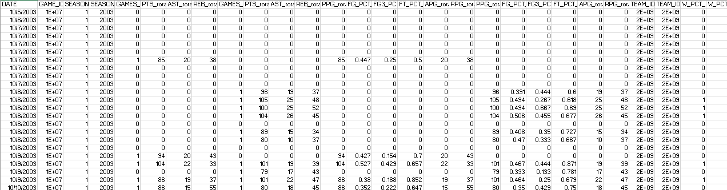
Preparing the Dataset
Problem:
Data shows stats after a game, so cannot be used for prediction
Solution:
Use existing data to build a new, cumulative stats dataset that includes all stats prior to a given game

Slide 5
Training Data
PPG_total_{home,away}
FG_PCT_total_{home,away}
FT_PCT_total_{home,away}
APG_total_{home,away}
RPG_total_{home,away}
W_PCT_{home,away}
All continuous
Total Features: 12

Slide 6
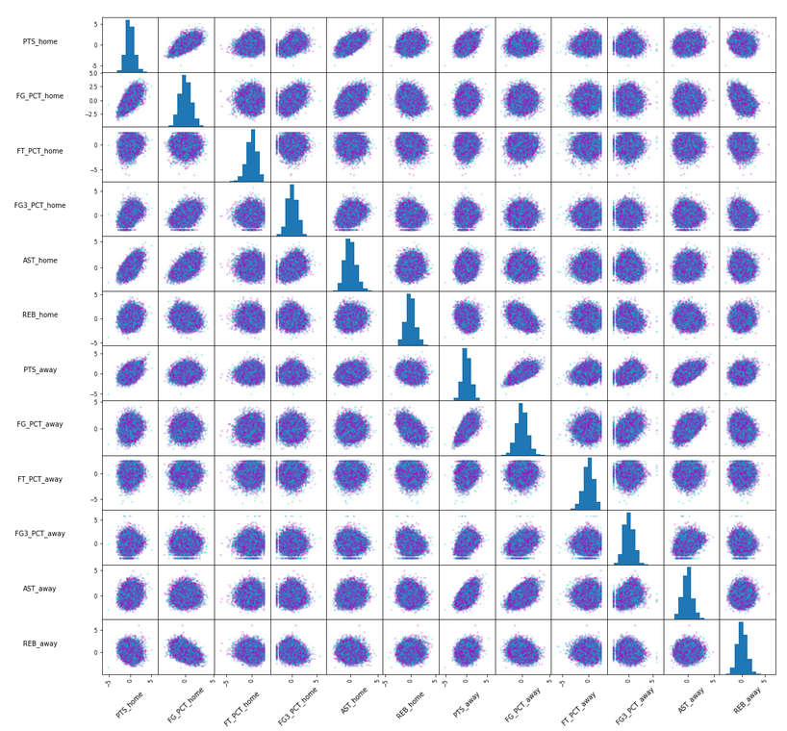
Target Data
Creating target data
Binary target data:
HOME_TEAM_WINS
HOME_HIGHER_FG_PCT
HOME_HIGHER_FG3_PCT
HOME_HIGHER_FT_PCT
HOME_HIGHER_AST
HOME_HIGHER_REB
Notes:
No apparent clusters or relationships

Slide 7
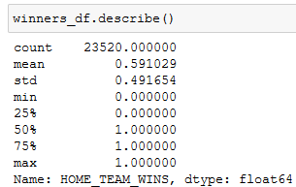
Evaluation Metrics
Optimize for accuracy
How to know accuracy is good?
Take mean of binary targets:
Always guessing that the home team wins yields 59.1% accuracy

Slide 8
Evaluation Metrics
Target accuracies to beat:
HOME_TEAM_WINS : 59.1% Win rate
HOME_HIGHER_FG_PCT : 55.0% Higher FGP rate
HOME_HIGHER_FG3_PCT : 50.8% Higher FG3 rate
HOME_HIGHER_FT_PCT : 49.5% Higher FTP rate
HOME_HIGHER_AST : 55.0% Higher AST rate
HOME_HIGHER_REB : 53.4% Higher REB rate
Also reflects class imbalance

Slide 9
Experiments - DecisionTreeClassifier
RandomizedSearchCV Hyperparameter Search, with 5-fold CV
{max depth, max leaf nodes, max features, class balancing}
Target | Target Accuracy | Pruning Method | Prediction Accuracy | Beat Target?
HOME_TEAM_WINS | 59% | max depth | 54% | N
HOME_HIGHER_FG_PCT | 55% | max depth | 50% | N
HOME_HIGHER_FG3_PCT | 51% | max leaf nodes | 51% | N
HOME_HIGHER_FT_PCT | 50% | max depth | 50% | N
HOME_HIGHER_AST | 55% | max depth | 50% | N
HOME_HIGHER_REB | 53% | max depth | 51% | N
ΔMacro Avg Accuracy: -2.8%
Worse than guessing
Notes:
(-5+-5+-0+-0+-5+-2)/6

Slide 10
Experiments - DecisionTreeClassifier
RandomOverSampler Oversampling and RandomizedSearchCV Hyperparameter Search, with 5-fold CV
Target | Target Accuracy | Pruning Method | Prediction Accuracy | Beat Target?
HOME_TEAM_WINS | 59% | none | 64% | Y
HOME_HIGHER_FG_PCT | 55% | max depth | 58% | Y
HOME_HIGHER_FG3_PCT | 51% | max features | 52% | Y
HOME_HIGHER_FT_PCT | 50% | none | 52% | Y
HOME_HIGHER_AST | 55% | max depth | 58% | Y
HOME_HIGHER_REB | 53% | max features | 56% | Y
ΔMacro Avg Accuracy: +2.8%
Good. All predictions beat target accuracy
Notes:
(5+3+1+2+3+3)/6

Slide 11
Experiments - DecisionTreeClassifier
SMOTEENN Over+Under Sampling and RandomizedSearchCV Hyperparameter Search, with 5-fold CV
Target | Target Accuracy | Pruning Method | Prediction Accuracy | Beat Target?
HOME_TEAM_WINS | 59% | none | 66% | Y
HOME_HIGHER_FG_PCT | 55% | max leaf nodes | 63% | Y
HOME_HIGHER_FG3_PCT | 51% | max depth | 60% | Y
HOME_HIGHER_FT_PCT | 50% | none | 59% | Y
HOME_HIGHER_AST | 55% | max depth | 62% | Y
HOME_HIGHER_REB | 53% | max depth | 60% | Y
ΔMacro Avg Accuracy: +7.8%
Best model
Notes:
(7+8+9+9+7+7)/6

Slide 12
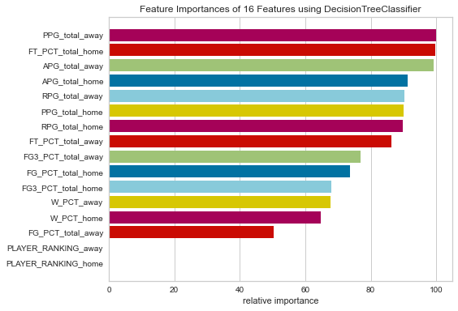
Experiments - DecisionTreeClassifier
Other attempts to improve accuracy:
Use RandomUnderSampler undersampling
Similar results to no class balancing
Use PCA to reduce Player Stats to 1-D to rank teams’ players, & include in training set
Decision tree ignores it
Use Regressors to predict numerical stats
Out of our scope
Notes:
RandomUnderSampler was the same as without balancing
PCA
Reduce each player’s stats to 1-D
Take mean of reduced stats
Include mean as new feature in training set
Decision tree ignored it altogether (see figure)
Scatter matrix - no obvious patterns or relationships, so regressors or clustering not feasible

Slide 13
Experiments - RandomForestClassifier
RandomizedSearchCV Hyperparameter Search, with 5-fold CV
{max depth, max leaf nodes, max features, class balancing}
Target | Target Accuracy | Pruning Method | Prediction Accuracy | Beat Target?
HOME_TEAM_WINS | 59% | max depth | 56% | N
HOME_HIGHER_FG_PCT | 55% | max depth | 53% | N
HOME_HIGHER_FG3_PCT | 51% | max leaf nodes | 50% | N
HOME_HIGHER_FT_PCT | 50% | max depth | 50% | N
HOME_HIGHER_AST | 55% | max depth | 52% | N
HOME_HIGHER_REB | 53% | max depth | 50% | N
ΔMacro Avg Accuracy: -2%
Worse than guessing
Notes:
(-3 -2 -0 -1 -3 - 3)/6

Slide 14
Experiments - RandomForestClassifier
RandomOverSampler Oversampling and RandomizedSearchCV Hyperparameter Search, with 5-fold CV
Target | Target Accuracy | Pruning Method | Prediction Accuracy | Beat Target?
HOME_TEAM_WINS | 59% | max depth | 66% | Y
HOME_HIGHER_FG_PCT | 55% | max depth | 58% | Y
HOME_HIGHER_FG3_PCT | 51% | max leaf nodes | 51% | N
HOME_HIGHER_FT_PCT | 50% | max depth | 52% | Y
HOME_HIGHER_AST | 55% | max depth | 59% | Y
HOME_HIGHER_REB | 53% | max depth | 55% | Y
ΔMacro Avg Accuracy: 2.67%
Good average
Notes:
RandomOverSampler - randomly selects minority entries & duplicates them
SMOTEENN - combines over and under sampling
(5 + 3 - 0 + 2 + 4 + 2)/6

Slide 15
Experiments - RandomForestClassifier
SMOTEENN Over+Under Sampling and RandomizedSearchCV Hyperparameter Search, with 5-fold CV
Target | Target Accuracy | Pruning Method | Prediction Accuracy | Beat Target?
HOME_TEAM_WINS | 59% | max depth | 71% | Y
HOME_HIGHER_FG_PCT | 55% | max depth | 69% | Y
HOME_HIGHER_FG3_PCT | 51% | max leaf nodes | 64% | Y
HOME_HIGHER_FT_PCT | 50% | max depth | 65% | Y
HOME_HIGHER_AST | 55% | max depth | 68% | Y
HOME_HIGHER_REB | 53% | max depth | 66% | Y
ΔMacro Avg Accuracy: 13.33%
Best Model
Notes:
RandomOverSampler - randomly selects minority entries & duplicates them
SMOTEENN - combines over and under sampling

Slide 16
Experiments - XGBClassifier
RandomizedSearchCV Hyperparameter Search, with 5-fold CV
{max depth, gamma, reg_lambda, eta,scale_pos_weight,class balancing}
Target | Target Accuracy | Pruning Method | Prediction Accuracy | Beat Target?
HOME_TEAM_WINS | 59% | gamma | 59% | N
HOME_HIGHER_FG_PCT | 55% | gamma | 55% | N
HOME_HIGHER_FG3_PCT | 51% | gamma | 51% | N
HOME_HIGHER_FT_PCT | 50% | max depth | 50% | N
HOME_HIGHER_AST | 55% | gamma | 55% | N
HOME_HIGHER_REB | 53% | gamma | 53% | N
ΔMacro Avg Accuracy: 0%
Similar to target accuracy

Slide 17
Experiments - XGBClassifier
RandomOverSampler Oversampling and RandomizedSearchCV Hyperparameter Search, with 5-fold CV
Target | Target Accuracy | Pruning Method | Prediction Accuracy | Beat Target?
HOME_TEAM_WINS | 59% | gamma | 64% | Y
HOME_HIGHER_FG_PCT | 55% | gamma | 57% | Y
HOME_HIGHER_FG3_PCT | 51% | gamma | 51% | N
HOME_HIGHER_FT_PCT | 50% | max depth | 51% | Y
HOME_HIGHER_AST | 55% | gamma | 58% | Y
HOME_HIGHER_REB | 53% | gamma | 53% | N
ΔMacro Avg Accuracy: +1.8%
Good. Most predictions beat target accuracy
Notes:
RandomOverSampler - randomly selects minority entries & duplicates them
SMOTEENN - combines over and under sampling
(5 + 3 - 0 + 2 + 4 + 2)/6

Slide 18
Experiments - XGBClassifier
SMOTEENN Over+Under Sampling and RandomizedSearchCV Hyperparameter Search, with 5-fold CV
Target | Target Accuracy | Pruning Method | Prediction Accuracy | Beat Target?
HOME_TEAM_WINS | 59% | max depth | 74% | Y
HOME_HIGHER_FG_PCT | 55% | none | 68% | Y
HOME_HIGHER_FG3_PCT | 51% | max depth | 65% | Y
HOME_HIGHER_FT_PCT | 50% | max depth | 64% | Y
HOME_HIGHER_AST | 55% | max depth | 70% | Y
HOME_HIGHER_REB | 53% | max depth | 67% | Y
ΔMacro Avg Accuracy: +14.1%
Best Model
Notes:
RandomOverSampler - randomly selects minority entries & duplicates them
SMOTEENN - combines over and under sampling

Slide 19
Discussions & Conclusions
Classifier | Macro Accuracy Gain
Decision Tree | 7.8%
Random Forest | 13.3%
XGBoost | 14.1%

